Slide 1
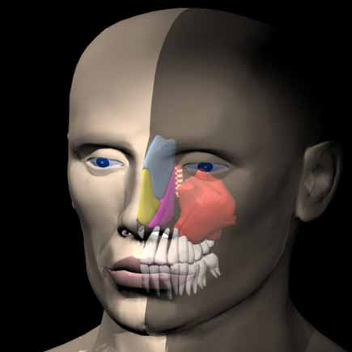
RUNGTA COLLEGE OF DENTAL SCIENCES & RESEARCH
Maxillary Sinus
DEPARTMENT OF ORAL PATHOLOGY

Slide 2
Specific learning Objectives
Core areas* | Domain ** | Category #
Introduction | COGNITIVE | MUST KNOW
Definition Anatomy (anatomical relations) Histology | COGNITIVE COGNITIVE COGNITIVE | MUST KNOW MUST KNOW MUST KNOW
Functions Clinical considerations | COGNITIVE COGNITIVE | MUST KNOW NICE TO KNOW

Slide 3
Content
Introduction
Definition
Anatomy (anatomical relations)
Histology
Functions
Clinical considerations

Slide 4
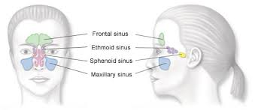
Sinus = Air filled sacs found in skull bone
Paranasal Sinus = found around nose

Slide 5
DEFINITION
It is pneumatic space that is lodged inside the body of maxilla & that communicates with environment by way of middle nasal meatus and nasal vestibule
Also called : Antrum of Highmore

Slide 7
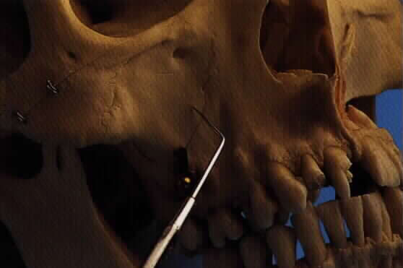
Anatomical facts and location:
√ The largest para-nasal sinuses.
√ Situated in the maxilla.
√ Has pyramidal shape.
Maxillary Sinus location :
Below cheeks
Above teeth
Sides of nose

Slide 9
ANATOMY
Pyramid shape – 4 sided
Horizontal pyramid shaped
Base
Apex
4 walls (Superior, inferior, posterior, anterior)
Base : medially towards nasal cavity
Apex : pointed laterally towards body of zygomatic bone

Slide 10
Zygomatic
bone
nasal
cavity
Apex
Base

Slide 11
Wall of maxillary sinus
Superior
Orbital surface , infraorbital foramen
Inferior
Alveolar process of maxilla , root of molar + premolar
Anterior
Canine fossa
Posterior
Infratemporal surface/ Pterygopalatine fossa

Slide 12
Orbital surface
Pterygopalatine
fossa
Canine fossa
Alveolar process

Slide 13
Base of the sinus = thinnest
Shows a perforation – “ostium” – opens at level of middle nasal meatus - communicates with nasal cavity

Slide 15
Anatomical morphology:
√ Size varies
√ Asymmetry
√ Small in children and grows up with aging.
√ Average height is about 3.5 cm, depth 3.2 cm and width 2.5 cm.
√ Capacity of about 15 cc (30ml)

Slide 16
Anatomical morphology:
√ Divided into several compartments by bony septa
(underwood’s septa)

Slide 17
Stages in the DEVELOPMENT of MAXILLARY SINUS
TIME | GROWTH | SHAPE
3/ 12 IU | Out pouching in middle meatus | --------
BIRTH | Tubular : 2cm x 1cm x 1cm | Tubular
9 years | 60% of adult size | ovoid
12 years | Antral floor parallels nasal floor | ---------
18 years | Adult size (4cm x 3cm x 3 cm) | pyramidal

Slide 18
HISTOLOGY
Three microscopically distinct layers surround the space of the maxillary sinus:
Epithelial layer
Basal lamina
Sub epithelial layer

Slide 19
HISTOLOGY
Pseudo = false
Stratified = layers
Columnar = length
Ciliated = posses cilia
EPITHELIAL LAYER
Lined with pseudo-stratified columnar ciliated epithelium
“Schneiderian membrane”
Most numerous cell type is the columunar ciliated cell.

Slide 21
In addition there are
Basal cells,
Columnar nonciliated cells, and
Mucus producing secretory goblet cells.

Slide 22
A ciliated cell
Cilia are composed of 9 + 1 pairs of microtubules, and they provide the motile apparatus to the sinus epithelium.
Function : Ciliary beating – moves mucous from sinus interior towards the nasal cavity

Slide 23
The goblet cell - Secretory cell.
Flask shaped
involved in the synthesis of the mucosubstances &
finally release this material onto the epithelial surface by exocytosis.

Slide 24
SUBEPITHELIAL LAYER
Sub epithelial glands are located
The acini of subepithelial glands contain two types of secretory cells
Serous
Mucus
The myoepithelial cells surround the acini

Slide 26
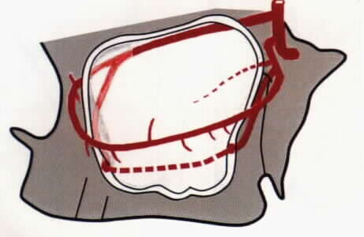
Blood supply:
Blood supply :
Facial, maxillary, infraorbital, greater & lesser palatine arteries and lateral and posterior nasal branches of sphenopalatine artery.
Venous drainage to the anterior facial vein, sphenopalatine vein and pterygopalatine plexus.

Slide 28
Nerve supply:
√ Infraorbital nerve.
√ Posterior, middle & anterior superior alveolar nerves.
√ Greater and lesser palatine nerves.

Slide 29
Lymphatic drain:
The lymphatic drain of the sinus is :
through the nose (or)
the submandibular lymph nodes.

Slide 30
Functions
Following functions have been proposed:
√ Contributes to speech via voice resonance.
√ Reduce weight of skull (lightens the skull)
√ Humidification & warming of inspired air.
√ Filtration of inspired air.
√ Mucus secreted by goblet cells traps the foreign substances & dust particles

Slide 31
√ Contribution to olfaction
√ Immunologic barrier ( body defense) – secretes immunoglobulin
√ Protects internal structures (brain & eyeball) from exposure to cold air
√ Bactericidal lysozyme to nasal cavity – antibacterial property

Slide 32
Clinical considerations
Agenesis : complete absence of sinus
Aplasia & Hypoplasia ( altered development or underdevelopment)
Supernumerary sinus : 2 completely separated sinus on same side
Oro-antral fistula: Invasion of the maxillary sinus and establishment of a direct communication with the oral cavity (complication of extraction of maxillary molars)

Slide 33
Sinusitis: Inflammation of sinus mucosa
It is often a complication of common cold & is accompanied by a clear nasal discharge or pharyngeal drainage.
the stuffiness & nasal discharge increase ,
& the patient may complain of pain & tenderness to pressure or swelling over the involved sinus.

Slide 34
Summary
The maxillary sinuses were first illustrated and described by Leonardo da Vinci in 1489
The maxillary sinus, or antrum of Highmore, lies within the body of the maxillary bone and is the largest and first to develop of the paranasal sinuses. The alveolar process of the maxilla supports the dentition and forms the inferior boundary of the sinus. It is of paramount importance for otolaryngologists, rhinologists, oral and maxillofacial surgeons, head and neck and dental and maxillofacial radiologists.

Slide 35
Take home message
Maxillary sinus is a pyramidal shape cavity in the body of maxilla
Average capacity of maxillary sinus is about 15ml

Slide 36
Maxillary sinus FAQs
Define maxillary sinus. Add a note on anatomy & structure of sinus
Functions of sinus
Histology of maxillary sinus/sinus epithelium
Clinical considerations of maxillary sinus

Slide 37
References
SN Bhaskar . Orban’s ,Oral Histology and embryology. 11th edition, Mosby 1998
Neville BW ,Damm DD ,Allen CM ,Bouquot JE . Oral and maxillofacial pathology , 2nd Edition .Philadelphia W.B. Saunders ;2002
Richard Tencate , Oral Histology development ,structure and function . 5th Edition ,1998
Carranza F.A., Michael G. Newman . Clinical periodontology 8,9,10th edition

Slide 38
THANKYOU

